Slide 1


Guidance for
Developing a
Global Pay Equity Strategy
Gail Greenfield
EVP, Pay Equity & Total Rewards Strategy & Solutions

Slide 2
Trusaic - Who We Are
Our mission
We believe in creating a better working world for all.
We do this by helping organizations:
Achieve pay equity
Foster a more diverse and inclusive workforce
Hire economically
disadvantaged individuals
Ensure employee access to affordable healthcare
At Trusaic, we believe in a world where everyone, regardless of their background or identity, deserves to thrive in the
workplace. We celebrate the mosaic of humanity, where diversity is both recognized and cherished.
We harness the power of technology for the greater good. Our vision extends beyond the workplace, as our mission
directly impacts individuals and their families, unlocking a more equitable society. We stand firm in our commitment to make the workplace work for everyone. The future is now.
2

Slide 3

Agenda
• Why Pay Equity Matters
• Global Pay Equity Strategy Framework
• Sample Pay Equity Strategy Roadmap
• Q&A

Slide 4

Why Pay Equity
Matters
• Legal and ethical imperatives
• Attracting and
retaining top talent
• Building a fair and
equitable workplace
4

Slide 5
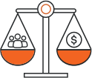






Global Pay Equity Strategy Framework
Prevention of Pay Inequities | Global Compliance & Reporting | Strategic Pay Transparency | Communication & Change Management
Proactive
Pay
Equity
Measurement
&
Accountability
5

Slide 6

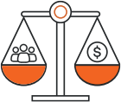
Proactive Pay Equity
On a regular basis, conduct a
proactive pay equity analysis to
evaluate your global pay equity
and address any unexplained pay
inequities identified.
Proactive
Pay
Equity

Slide 7
What Do We Mean by Pay Equity?
“Raw”
Pay Gap
How average or
median pay differs
by demographic
group (e.g., women
vs. men; Black vs.
White)
“Explained” Pay Gap
“Unexplained” Pay Gap
Residual pay gap that
cannot be explained
and may be due to
pay inequities; also
referred to as the
“adjusted” or
“controlled” pay gap
=
+
How pay differs
by demographic group
due to differences in
compensable factors
such as occupation,
role, education, and
experience
7

Slide 8
Illustrative Example of Pay Gaps
Avg.
Men’s Pay
$100,000
Unexplained Pay Gap
($5,000)
Explained Pay Gap ($15,000)
Raw Pay Gap ($20,000 or 20%)
a.k.a. “women earn 80 cents for every dollar a man earns”
In this hypothetical example, the raw pay gap between men and
women is driven mainly by the explained pay gap ($15,000),with a smaller portion ($5,000) left unexplained.
Avg.
Women’s
Pay
$80,000
The primary objective of a proactive pay
equity analysis is to measure an
organization’s unexplained pay gap and
close it where appropriate
Illustrative Example
8

Slide 9
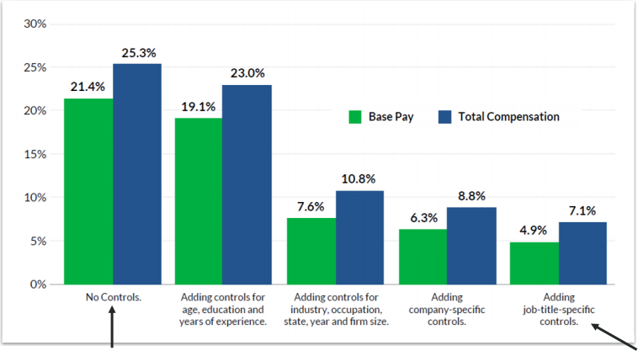
Measuring Pay Gaps Using Multiple Regression
U.S. Gender Pay Gap, Before and After Adding Statistical Controls
Raw Pay Gap
Source: Glassdoor Economic Research, Progress on the Gender Pay Gap: 2019
Unexplained Pay Gap
9
9

Slide 10



Prevention of Pay Inequities
Implement policies, processes,
and tools with the aim of
preventing pay inequities
throughout the employee
lifecycle.
Prevention
of Pay
Inequities

Slide 11
How To Prevent Pay Inequities
Hire
• Every pay decision is an opportunity to help prevent or potentially exacerbate a pay inequity.
• Here are two methods to help ensure that pay decisions are not inadvertently putting your pay equity at risk:
1. Policies & Processes: Implement reasonable procedures to review pay decisions before they are finalized.
2. Tools: Implement technology that can assist decision-makers with data needed to make unbiased pay decisions that are
consistent with internal equity.
Promotion
Off-Cycle Adjustment
Pay
Decision
Merit
11

Slide 12


Global Compliance & Reporting
Comply with all
compensation-related laws,
regulations, and reporting
requirements in the
jurisdictions in which you
operate.
Global
Compliance & Reporting
12

Slide 13
Ways To Organize Global Compliance & Reporting
Managed Managed
Managed Locally
Locally
with Centralized Oversight
Centrally
• There are a variety of ways to organize jurisdiction-based compliance and reporting efforts, from completely local on one end of the spectrum to completely centralized on the other end.
• Given idiosyncrasies associated with the data and requirements in each jurisdiction, local management of the process may be advisable for some organizations, along with centralized oversight, guidance, and tools to
ensure global consistency.
• However, with the passage of the EU Pay Transparency Directive, it might be prudent for companies with employees in the EU to pivot toward a more centralized approach.
13

Slide 14


Strategic Pay Transparency
Every company must decide
what discretionary information it
wants to share and who it wants to share it with, taking into
consideration the quickly
shifting norm toward greater pay
transparency.
Strategic
Pay
Transparency

Slide 15






A Strategic Way To Think About Pay Transparency
• Pay transparency refers to the extent to
which an organization chooses to share
information about its compensation
philosophies, policies, and practices internally
and externally.
• While organizations must comply with legally
mandated pay transparency reporting
requirements (e.g., UK gender pay gap,
California pay transparency law), they must
also decide whether their pay transparency
approach will go beyond what is legally
required. It’s this discretionary component
that defines an organization’s pay
transparency approach.
e.g., Pay Ranges
What do we share?
e.g., Pay Equity Gaps
e.g., Raw Pay Gaps
Pay Transparency Approach
Internal (e.g., Board, Leaders, Managers, Employees)
Who do we share with?
External (e.g., Applicants, Candidates, Public)
15

Slide 16


Communication & Change
Management
Deliver communications,
education, and training to
support your global pay equity
strategy.
Communication
& Change
Management

Slide 17
Developing a Communication Plan
Who needs to
know?
• Decisions you make about your pay equity strategy will have communication and change management implications.
• For each facet of your pay equity strategy, ask yourself the following questions to assist with developing an effective communication plan:
1. Who needs to know about this? E.g., HR, Employees, Applicants/Candidates, Managers, Leaders, Board.
2. What information does each audience need to know? E.g., 30,000-Foot View, Overview, Detailed Understanding.
3. How is the information best communicated to each audience? E.g., In-Person Meeting, Email, Toolkit + FAQ, Recorded Training, Instructor-Led Training.
• Work with your legal counsel on developing your communication plan!
What
information does
the audience
need?
How is the
information best
communicated?
17

Slide 18


Measurement & Accountability
Create and implement a global
measurement framework to track progress and drive
accountability.
Measurement
&
Accountability

Slide 19
Creating a Measurement Framework
• Developing a measurement
framework and tracking progress over time can help drive
accountability for pay equity
outcomes within your organization.
• For some organizations, an
enterprise-wide view may be
sufficient. For others, it may be
preferable to measure progress at the leader level or the line of
business level. The choice should align with lines of authority.
• It’s recommended that you develop measures for each facet of your pay equity strategy.
Sample Measures
Proactive Pay Equity ► Raw pay gap ► Adjusted pay gap ► Percent below job minimum ► Percent above job maximum |  | Comm. & Change Management ► Percent of managers with pay transparency training ► Percent of Employees meaningful discussion about pay with manager in past year
Prevention of Pay Inequities ► Percent of offers below, within, and above equitable range ► Percent of offers below, within, and above range minimum and maximum | Global Compliance & Reporting ► Jurisdictions in/out of pay transparency compliance ► Jurisdictions in/out of reporting compliance | Strategic Pay Transparency ► Percent of U.S. job postings with pay ranges ► Percent of ex-U.S. job postings with pay ranges
19

Slide 20
Sample Pay Equity Strategy Roadmap
Year 1
Year 2
Year 3
Proactive Pay Equity | Conduct analysis for US | Expand analysis to UK | Expand analysis to ROW
Prevention of Pay Inequities | Research tools/software to prevent pay inequities at hire | Select tool and roll out in US | Roll out to ROW
Global Compliance & Reporting | Planning for centralized approach to reporting | Research tools/software to support centralized reporting | Implement global pay reporting tool
Strategic Pay Transparency | Roll out pay ranges in all US job postings | Expand to EU countries | Expand to ROW
Communication & Change Management | Train managers in US on pay transparency | Train managers in EU on pay transparency | Train managers in ROW on pay transparency
Measurement & Accountability | Develop and socialize measurement scorecard | Roll out scorecard in US | Roll out scorecard in ROW
20

Slide 21

Questions?
For more information:
Gail Greenfield
EVP, Pay Equity & Total Rewards Strategy & Solutions
Phone: (213) 418-1987
Email: ggreenfield@trusaic.com
Trusaic
www.trusaic.com
discover@trusaic.com
520 S Grand Ave., Suite 200
Los Angeles, CA 90071

Slide 22
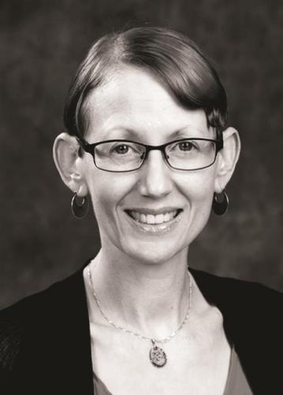
Today’s speaker from Trusaic
Gail Greenfield
EVP, Pay Equity & Total Rewards
Gail is an eminent pay equity expert who recently joined Trusaic as Executive
Vice President of Pay Equity and Total Rewards Strategy and Solutions. With
over 20 years of experience, she specializes in developing data-driven
strategies to promote workplace diversity, equity, and inclusion. Gail's career
includes roles at Oracle and Warner Brothers Discovery, and she has a rich history at Mercer, where she testified before Congress on diversity and
inclusion. Her insights on pay equity have been featured in major media
outlets, and she is a respected speaker at industry events. Gail holds a PhD
in economics from Claremont Graduate University and a bachelor's degree in business economics from University of California, Santa Barbara.
22

